Slide 1

World Vacation

Slide 2
Concept
Description - This is a vacation app that enables searching for weather & demographic details of a city of your choice.
Motivation for development - To identify the best city and country for your travel needs - based on the weather and its unique features.
User story - As a traveller, I would like to travel & explore different cities offering a) Unique weather patters
b) Enriching cultural styles and
c) Eye-catching tourist attractions

Slide 3
User Story
As a traveller, I would like to travel & explore different cities
GIVEN a search engine for city input
WHEN I search for a destination city
THEN I am presented with the city’s
Weather
Demographic features
Population
Tourist information

Slide 4
Process
Key Tasks
A website - 4 pages
APIs for Weather & Demography
Technologies used
HTML
Tailwind CSS
JavaScript
Server-side APIs
Challenges
Identifying and applying the appropriate API for the project.
Applying Tailwind CSS for the webpage design
Enabling JavaScript-based logic

Slide 5
Project Roles
Initial proposal & wireframes - Sakariya Adam
Webpage Coding & Design
API Sourcing & Coding
Landing page - Veera Pagadala
About page - Veera Pagadala
Search page - Faduma Dahir
Reviews page - Matteo Neri
Weather API - Veera Pagadala
Demographic API - Sakariya Adam

Slide 6
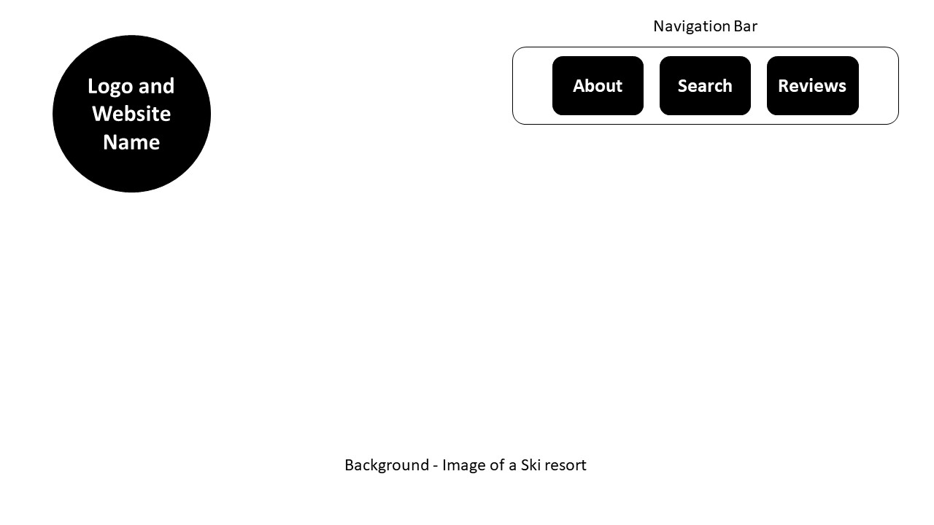
The Landing Page
Prototype
https://veerak21.github.io/world-vacation/

Slide 7
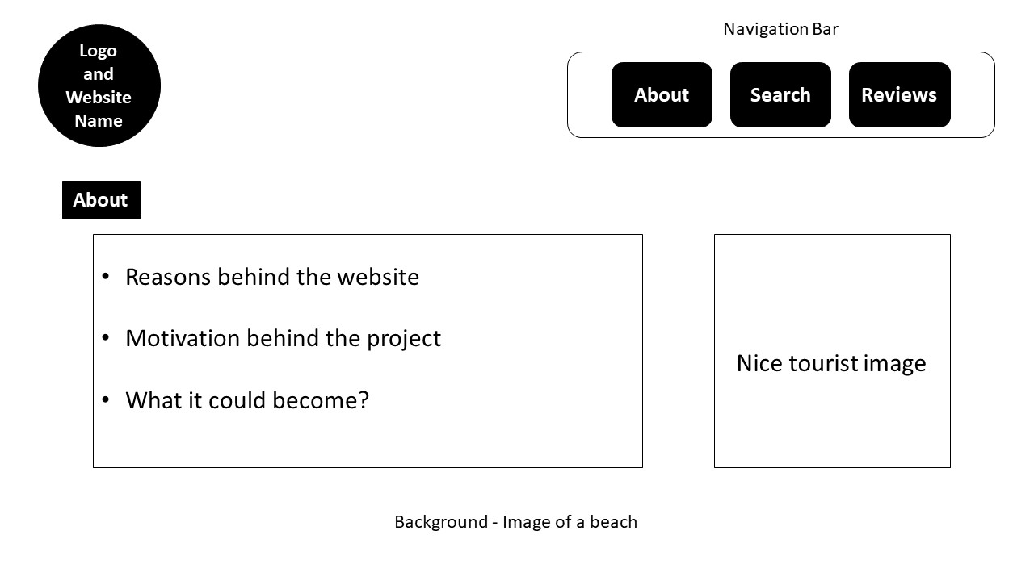
About Page
Prototype

Slide 8
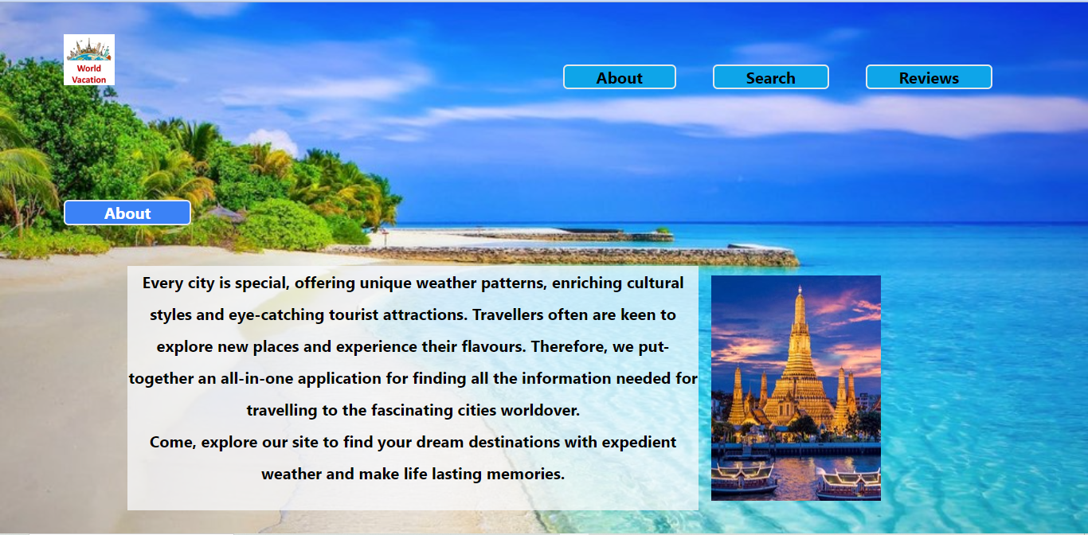

Slide 9
Directions for Improvement
Provide travel based information, such as local languages and cuisine.
Cultural activity calenders for different cities.
Display Health-care specific information for travellers.

Slide 10
Key Links
Deployed at: https://veerak21.github.io/world-vacation/
GitHub repository: https://github.com/veerak21/world-vacation

